Slide 1
TASK-2
PREDICTION OF CUSTOMER PURCHASE BEHAVIOUR USING A RANDOM FOREST CLASSIFIER

Slide 2
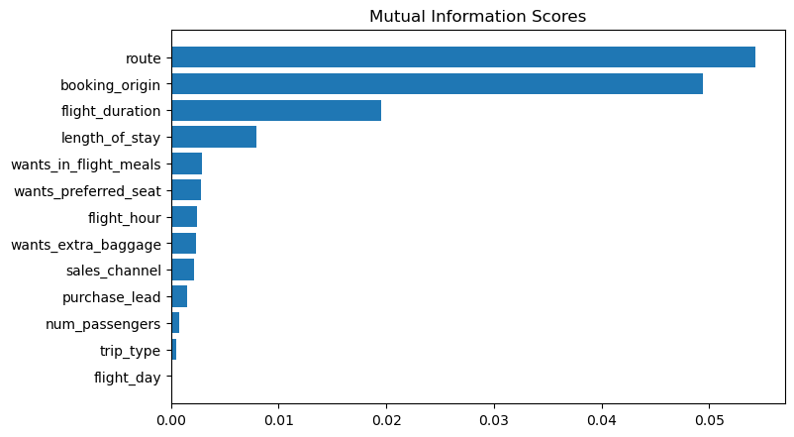
Observing that the features 'route,' 'booking_origin,' 'flight_duration,' 'wants_extra_baggage,' and 'length_of_stay' are the top five features correlated with the 'booking_complete' feature.
ACCURACY: 84.84 AUC score: 0.5527766076821664

